Slide 1
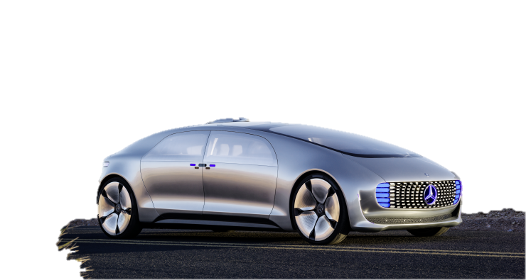
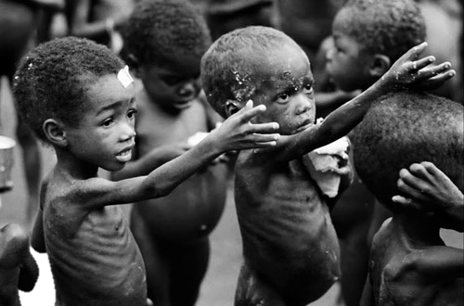
Creativity Pays the Bills
Creativity & Innovativeness Workshop
CMS Skills to Pay the Bills Workshop 2018

Slide 2
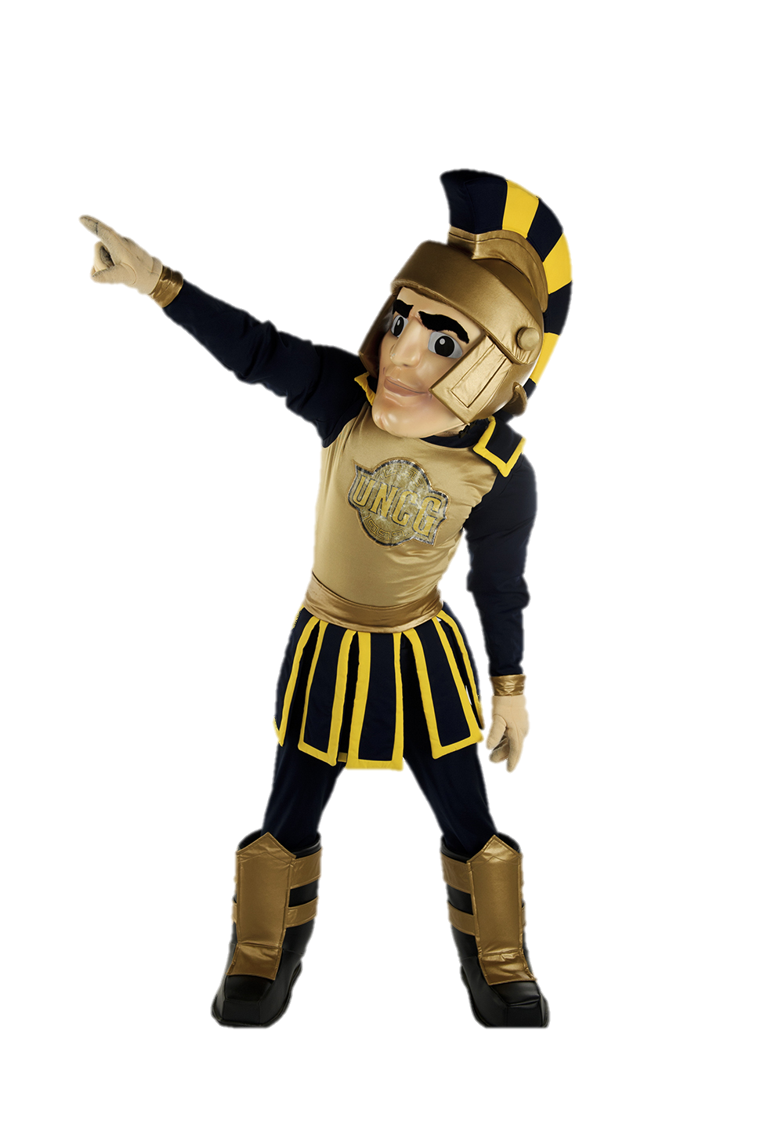
The world needs more creative people to solve our tough problems.
Creative people do not have all the answers, but they habitually question the way things are always done and think about alternatives and improvements.
They discover and invent possible answers. They habitually ask better questions. They have optimism.
When combined with empathy and compassion, creativity is bound to be a force for good.

Slide 3
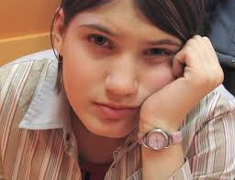
BUT….I am NOT Creative
Kindergarten…Did you like to draw, sing, act? Did you like to pick out your own clothes? Build forts and sandcastles? Did you have a make believe friend?

Slide 4
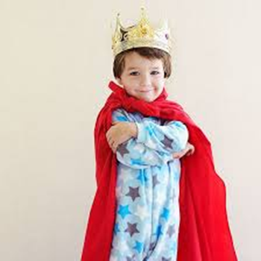
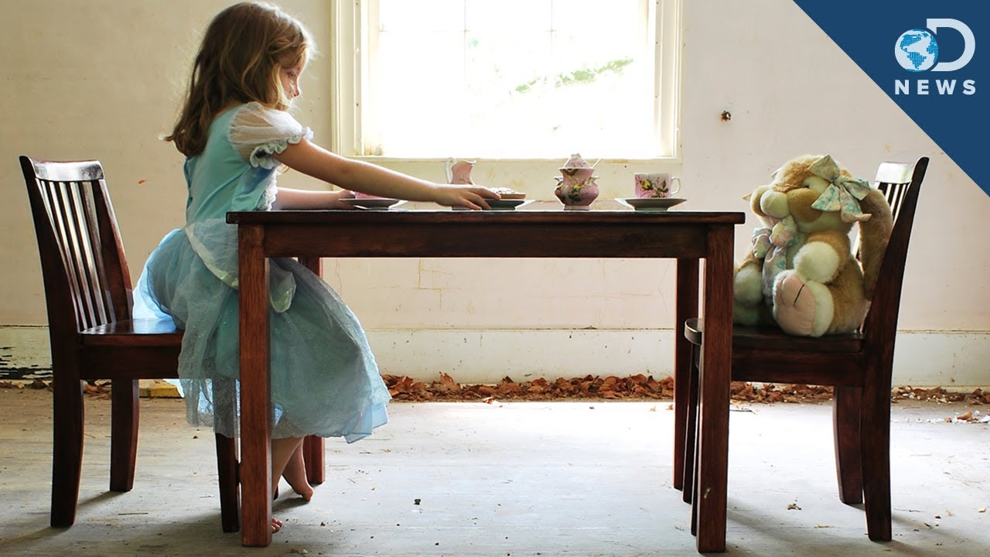
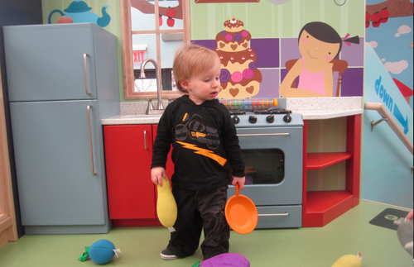

Slide 5
We need Everyone’s Help

Slide 6
We Need Everyone’s Help
BE POSITIVE - Creative brainstorming sessions are not the time to criticize or point out weaknesses or faults. Allow all ideas and build on strengths. (Sometimes the most brilliant solutions come from the craziest ideas)
BE SUPPORTIVE – People’s creative ideas are fragile. Creativity flourishes in nurturing, safe environments
BE PERSISTENT – A lot of creative ideas come after failures. (trial and error)

Slide 7
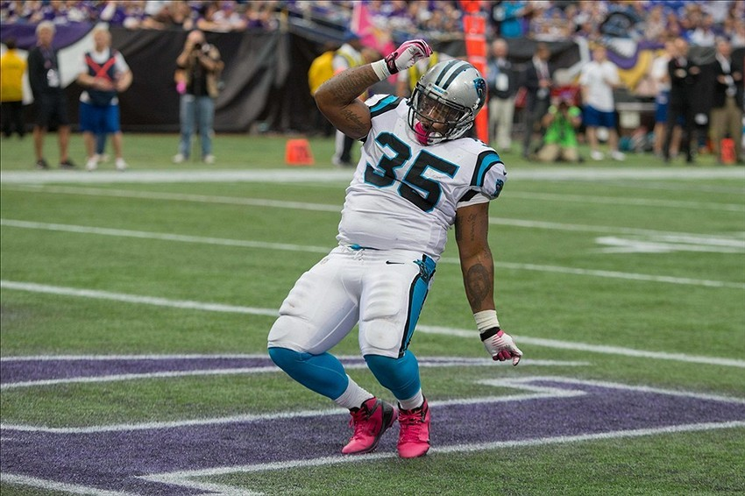
The Activity
Design a new company that owns and operates a store within CMS.
Ignore what you already know about actual school stores and come up with a winning, creative idea from scratch. The store could sell a PRODUCT OR SERVICE. Does not need to be “possible” but should be ethical.

Slide 8
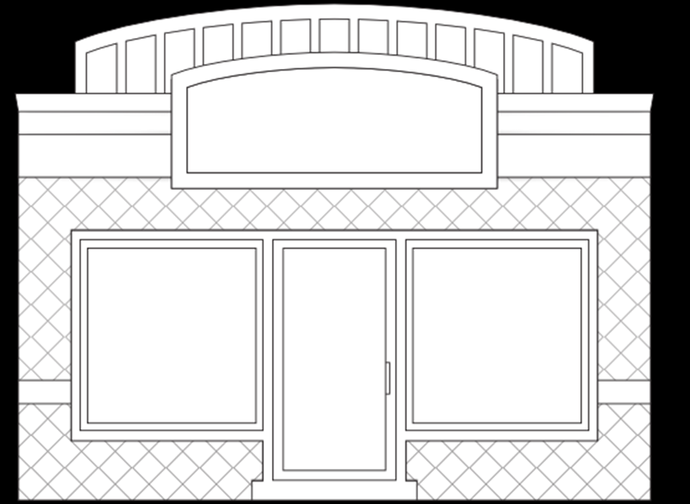
Store Name
Product/Service Description
Price
Location
Store Hours

Slide 9
Four Brainstorming Strategies
Imagine how different people might view the problem and possibly solve it. (kindergartener, teacher, grandparent, clown, president, policeman) | A B C D E F G Method – idea for each letter of alphabet
S.C.A.M.P.E.R. S. Substitute C. Combine A. Adapt, Alter, Flip M. Minimize P. Put to Other Use(s) E. Eliminate R. Reverse | Mind Mapping: Divide your task into its various parts. Then using the parts as categories make a chart with 7 to 12 variables for each part or category.

