Slide 1
Manage your time
Like a boss
Planning & Time management workshop
Cms Skills to pay the bills workshop 2018

Slide 2
Is your life in order?
The inside of my locker is usually clean.
My workspace at home is free of clutter.
My computer files are in order and it is easy to find documents.
I maintain an agenda to manage my deadlines and assignments.
I make my bed every day.
Source: Professionalism. Skills for Workplace Success
Notes:
To make this slide interactive, consider having students stand if they can check off one item on this slide. Stay standing if they can check off two or more… etc.
Help students establish a connection between time management and success and that employers need employees who are healthy, relaxed and well organized. Share any examples of interview questions or real world examples.
Reinforce the importance to correct and bad habits now and practice organization. Poor time management and planning creates stress. Point out that some stress can keep people mentally challenged– it will give you the adrenaline and mental/physical strength to finish a project. However, if you consistently have stress it can be very negative. Negative stress and getting overwhelmed can cause you to get too emotional, illogical and can affect your mental and physical health.

Slide 3
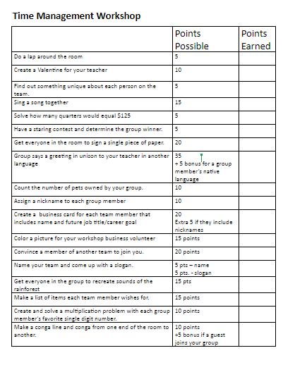
Lists & Priorities group activity
10 minutes
10 minutes to complete as many tasks as possible
Notes:
***REDUCE TIME GIVEN FOR GROUPS TO COMPLETE THE LIST IF NECESSARY TO HAVE TIME TO DEBRIEF** This simulation recreates a situation where an overwhelming to-do list needs to be managed. Students work in groups at school (and will in the workplace) and need to learn how to complete complex projects together – on time and on task. Other than directions, avoid giving too many hints about prioritizing or how to choose. This activity is designed for students to learn together through trial and error. Be sure to save time to debrief. In real-life situations, students and their groups will need to formulate the task lists themselves as an important first step in group work.

Slide 4
Lists & priorities activity reflection
How did your team decide what tasks they wanted to do?
Describe how you think it went with the different personalities of your group.
What did your group do well?
What could your group have done better?
What lessons did you learn about time management with group projects?
Notes:
See Activity Instructions for important debriefing points to emphasize with students.

Slide 5
Time Management
Dos
Make a to-do list and prioritize
Keep a calendar/planner/agenda
Practice a one-touch policy (put papers & belongings where they belong)
Ask for help with organization, stress & time management. Break bad habits now with help and practice!
Source: Professionalism. Skills for Workplace Success
Notes:
Share any workplace connections or examples with the kids if time allows. When prioritizing – remind kids what they learned in the activity (batch related activities, find tasks that are important and can be accomplished quickly, consider their skills and interests – do activities that need the most focus at a time of day that matches.

Slide 6
Procrastination support
Don’ts
Procrastinate (put off tasks til a later time)
Instead
Visualize the completed project for motivation (End Result + Feeling)
Make a list of every to-dos
Break overwhelming tasks into smaller ones
Create a schedule
Plan and take breaks and celebrate completing certain steps when you are working on a big project.
Notes:
People procrastinate for a variety of reasons: Fear of failure, perfectionism, disorganization or not wanting to do an unpleasant task. Share strategies for reversing this habit.

