Slide 1

Have a Hand in Inclusion
Diversity & Inclusion
CMS Skills to Pay the Bills
Workshop 2018

Slide 2

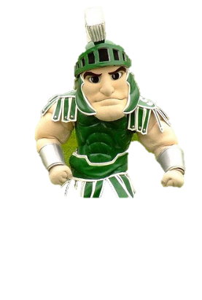
Notes:
Begin with this poignant prompt to establish context for the workshop. Direct the students to close their eyes.
Close your eyes and imagine that everyone in the room is the same. Exactly the same! Same hair, eye color, height, weight, gender, race, language. Everyone dresses the same and sounds the same.
Now open your eyes, look to your left and your right.
What do you see?
Have students complete the survey and reflect on ways that they are unique.

Slide 3

Agenda
What is Diversity and Inclusion
Benefit of Diversity and Inclusion
Strategies and practice with including and connecting with others

Slide 4
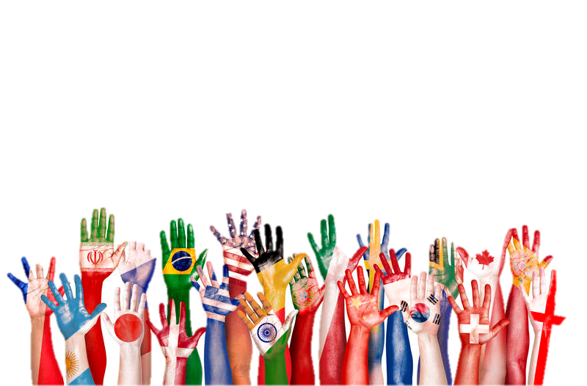
Diversity Means
Each individual is unique
More than just race and culture
Gender, learning styles economic status, age,
physical abilities, religious beliefs, political beliefs & more!
Notes:
People’s race and biology are one aspect of diversity (affect gender, body size, skin, hair and eye color. However, CMS students and people at work are different in a lot of ways:
Ethnicity & Culture: customs, language, sense of identity
Family Life: Family Size, birth order, values, traditions, social class
Beliefs: Religion or philosophy of life
Geography: How one feels about being from a certain neighborhood, city or region
Experiences: School, work, travel, recreation, with other people

Slide 5

What is Inclusion
Inclusion is about promoting an environment where every individual is valued.
As individuals, we bring our differences into the school and the workplace.

Slide 6
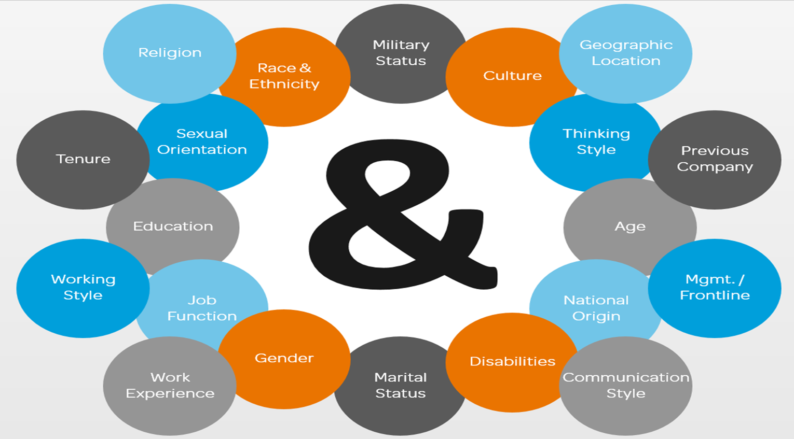
Dimension of Diversity
Every Voice Matters

Slide 7
Why Should I Understand Diversity?
We all see the world a bit differently. Understanding people’s differences gives you new insights and outlook!
Companies and communities value diversity. In today’s global world, companies seek out a diverse staff to gives us a competitive advantage for creating and innovating. Therefore, companies seek employees who are inclusive and understand and work well on a diverse team.
Notes:
Share any workplace D& I experiences: experience working on a diverse team, rituals/ways your team unites, ways your company has designed polices, hiring practices and/or customer experiences to be more inclusive, etc.
You could also point out inclusiveness is expected by companies because doing otherwise is not only offensive, but also can violate people’s civil rights and be construed as harassment or workplace discrimination. Companies want

Slide 8


Have A Hand at Inclusion at CMS and in the Real World
Recognize any biases or stereotypes you may have absorbed.
Treat each student as an individual and get to know people. Build your cultural awareness for your school and career success!

Slide 9
More Strategies
Change any language you use that excludes or puts down other groups.
Learn and practice respectful behavior
If you offend someone, find out what behavior offended them, apologize if necessary and try not to do it again.

Slide 10
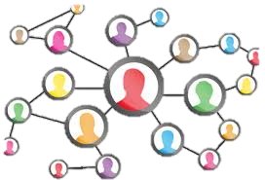

Activity Time
Notes:
Let’s celebrate people’s uniqueness and make some new connections.

