Slide 1
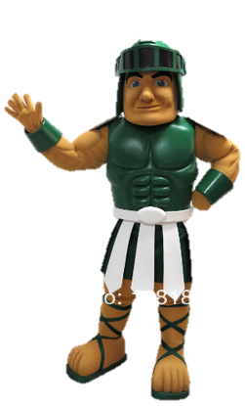
Choose A Professional Attitude CMS Skills to pay the bills workshop 2018

Slide 2
Class Discussion: What are some stereotypes society has about teenagers?
Notes:
Call on students to share their ideas and record their brainstorming on the dry-erase board. Share any of your personal connections. Help students acknowledge any of their own contributions to teen stigma behaviors. Share some encouragement that more positive attitudes and behaviors are important and possible!

Slide 3
Important Factors in Getting and Keeping a Job
40% - Attitude
25% - Image and appearance
25% - Communication skills (verbal & non-verbal)
10% - Job skills
Source: US Dept. of Labor
“Mastering Soft Skills for Workplace Success”
Notes:
Share any brief personal workplace connections to validate this data. How is attitude asked about and evaluated in an interview? How do you gauge a coworker, employee and/or job applicant’s attitude?
Bottom line: Attitude affects an individual’s performance, which in turn affects a group and then an organization’s performance. Right now students are in school. School is different from work in that schools are student centered – they make choices based on what’s best for students. In the workplace, employers will not tolerate bad attitudes since they negatively affect performance.

Slide 4
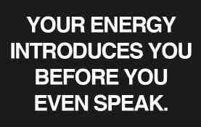
I’m Excited To Be Here!
I’m Excited To Be Here!
I’m Excited To Be Here!
Notes:
Employers expect a good
impression on that first encounter. Businesses often operate by taking risks, and one of the greatest
financial risks involves the hiring of employees. Practice this first impression by having the students read this phrase as a class 3X.

Slide 5
BEWARE of the + Attitude VILLAINS
Negative Environment
Other People’s Behavior
Change
Past Experiences

Slide 6
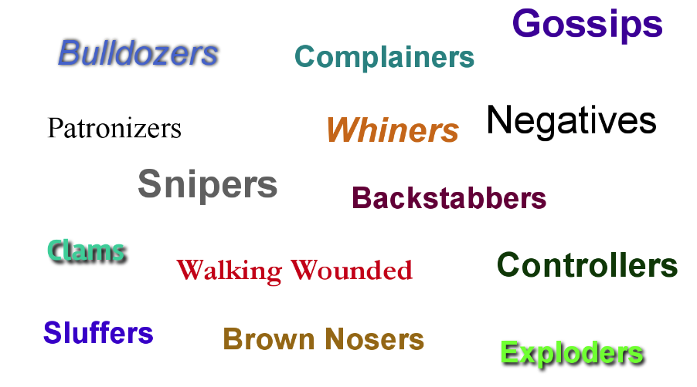
Other People’s Behavior
Notes:
Share with students that it’s best to stay away from negative people; however, negative influences can not always be avoided (relatives, assigned group members, etc.) Encourage them to surround themselves with positive people as much as possible. Find people who love you, support you are faithful to you and are truthful.

Slide 7
Negative Environment
Overly Competitive
Feel unappreciated
Too much work… not enough help
Feel Unsafe
Need more money
Friendship/relationship issues
Lack of goals, management and direction

Slide 8
Changing Environment
Do you get bent out of shape????
Change …
Alters the way we think
Makes life more difficult for awhile
Causes feelings of stress, confusion, frustration, resistance
Is an ongoing fact of life

Slide 9
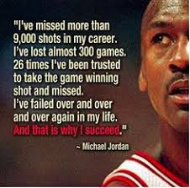
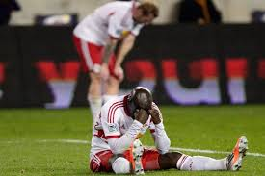
Past Experiences/Failures
Notes:
Confront past experiences and admit that they happened instead of hiding or denying it. Forgive, heal and learn from the experience. Move forward by letting go of hurt, guilt and /or embarrassment. Seek support if something is really bothering you and you need help moving forward.

Slide 10
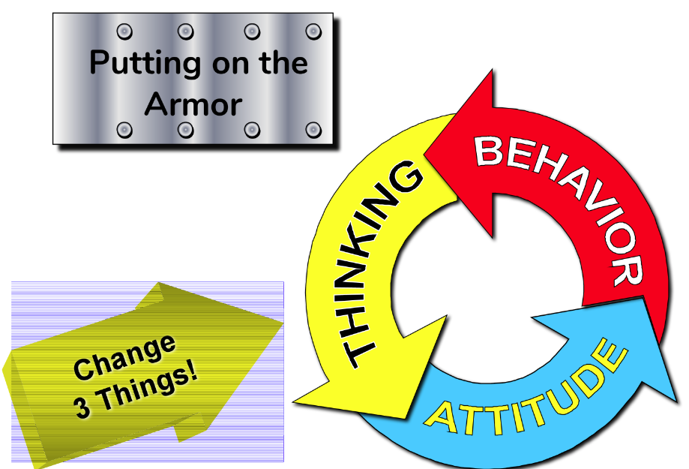

Slide 11
How to change your
Attitude | Thinking | Behavior
Acknowledge your situation & feelings (the good and the bad) Accept responsibility for your attitude Take control: Goals + Discipline | Observe your thinking for patterns you need to change Positive self talk & Enthusiasm “I’m excited to be here!” Focus on the good of each day Sprinkle some positive on the negatives Open your mind to change Sense of Humor Forgive | Pause and choose your behavior and your reactions (social media, anger, bad habits, etc) count to 10, 100, 1000 Smile more Stay away from negative people and environments Say please and thank you Compliment others Keep promises

Slide 13
Positive Environment Class Activity
2 Volunteers Needed
Notes:
Ask for two volunteers that would be willing to complete a mystery task in front of the whole class. Dismiss the volunteers to wait in the hallway while you brief the class. Explain to the class what task that the volunteers will do (ie. pick up water bottle/pencil from a nearby desk and bring to you). Instruct the class that they are to help volunteer 1 figure out what task to do by calling out “no” when volunteer 1 is making a wrong move for completing the task. They can only say no to help volunteer 1 and vice versa to volunteer 2 (note: volunteer 1 may not be able to complete task; end when volunteer is beginning to get discouraged. Try to facilitate volunteer 2 completing the task)
Conduct the “no” simulation with volunteer 1. (Volunteer 2 should remain in hall)
Repeat the simulation with volunteer 2.
Emphasize the success that comes from

